Slide 1

Chapter 13: Reference
Why reference
Evaluation
Typing
Store Typings
Safety

Slide 2
References
Notes:
Ocaml is a functional language rather than a procedural programming one;
the key difference between these two classes of languages is the execution model -the way in which programs are executed.
--- Procedural (or imperative) languages, such as C/Java, are based on commands that change the state of machine
on which they execute, e.g., the assignment statement explicitly changes the value stored in some memory location.
---- Functional languages, in contrast, are based on evaluating expressions to produce values.

Slide 3

Computational Effects
Also known as side effects.
A function or expression is said to have a side effect if, in addition to returning a value, it also modifies some state or has an observable interaction with calling functions or the outside world.
modify a global variable or static variable, modify one of its arguments,
raise an exception,
write data to a display or file, read data, or
call other side-effecting functions.
In the presence of side effects, a program's behavior may depend on history; i.e., the order of evaluation matters.

Slide 4
Computational Effects
Side effects are the most common way that a program interacts with the outside world (people, file systems, other computers on networks).
The degree to which side effects are used depends on the programming paradigm.
Imperative programming is known for its frequent utilization of side effects.
In functional programming, side effects are rarely used. Functional languages like Standard ML, Scheme and Scala do not restrict side effects, but it is customary for programmers to avoid them. The functional language Haskell expresses side effects such as I/O and other stateful computations using monadic actions.

Slide 5
Mutability
So far, what we have discussed does not yet include side effects .
In particular, whenever we defined function, we never changed variables or data. Rather, we always computed new data.
E.g., the operations to insert an item into the data structure didn't effect the old copy of the data structure. Instead, we always built a new data structure with the item appropriately inserted.
For the most part, programming in a functional style (i.e., without side effects) is a "good thing" because it's easier to reason locally about the behavior of the program.
Notes:
Good thing?

Slide 6
Mutability
In most programming languages, variables are mutable — i.e., a variable provides both
a name that refers to a previously calculated value, and
the possibility of overwriting this value with another (which will be referred to by the same name)
In some languages (e.g., OCaml), these features are separate:
variables are only for naming — the binding between a variable and its value is immutable
introduce a new class of mutable values (called reference cells or references)
at any given moment, a reference holds a value (and can be dereferenced to obtain this value)
a new value may be assigned to a reference

Slide 7
Mutability
Writing values into memory locations is the fundamental mechanism of imperative languages such as C/C++.
Mutable structures are
required to implement many efficient algorithms.
also very convenient to represent the current state of a state machine.
Notes:
define a type
person
as in the previous chapter. Then, it seems natural to
allow a person to change his/her age, job and the city that person lives in, but
not
his/her name.

Slide 8

Basic Examples
#let r = ref 5
val r : int ref = {contents = 5}
// The value of r is a reference to a cell that always contain a number.
# r:= !r +2
# !r
-: int = 7
(r:=succ(!r); !r)
(r:=succ(!r); r:=succ(!r); r:=succ(!r); r:=succ(!r); !r)

Slide 9

Basic Examples
# let flag = ref true;;
-val flag: bool ref = {contents = true}
# if !flag then 1 else 2;;
-: int = 1

Slide 10

Reference
Basic operations
allocation ref (operator)
dereferencing !
assignment :=
Is there any difference between the expressions of ?
5 + 8;
r: =7;
(r:=succ(!r); !r)
Notes:
? Difference ?

Slide 11

Aliasing
A value of type ref T is a pointer to a cell holding a value of type T.
r =
5
If this value is “copied” by assigning it to another variable： s=r; the cell pointed to is not copied. ( r and s are aliases)
r =
s =
5
So we can change r by assigning to s:
(s:=10; !r)

Slide 12
Aliasing all around us
Reference cells are not the only language feature that introduces the possibility of aliasing
arrays
communication channels
I/O devices (disks, etc.)

Slide 13
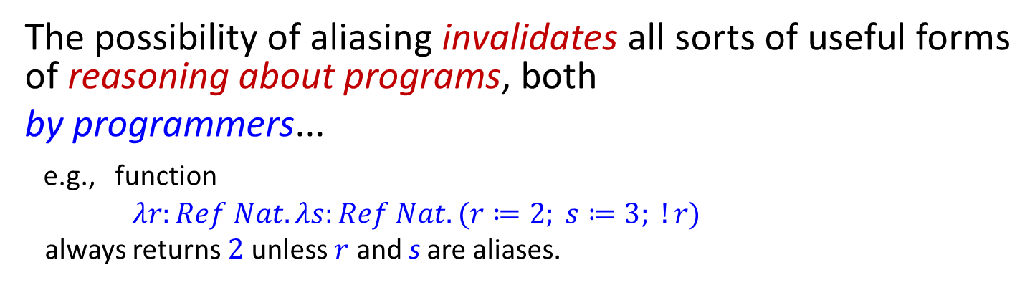
The difficulties of aliasing
The possibility of aliasing invalidates all sorts of useful forms of reasoning about programs, both
by programmers...
e.g., function
$λr:Ref Nat. λs:Ref Nat. (r≔2; s≔3; !r)$
always returns $2$ unless $r$ and s are aliases.
... and by compilers:
Code motion out of loops, common sub-expression elimination, allocation of variables to registers, and detection of uninitialized variables all depend upon the compiler knowing which objects a load or a store operation could reference.
High-performance compilers spend significant energy on alias analysis to try to establish when different variables cannot possibly refer to the same storage.

Slide 14
The benefits of aliasing
The problems of aliasing have led some language designers simply to disallow it (e.g., Haskell).
However, there are good reasons why most languages do provide constructs involving aliasing:
efficiency (e.g., arrays)
“action at a distance” (e.g., symbol tables)
shared resources (e.g., locks) in concurrent systems
...…
Notes:
Software bugs due to "action at a distance" may arise because a program component is doing something at the wrong time, or affecting something it should not. “It is very difficult, however, to track down which component is responsible”.
Side effects from innocent actions can put the program in an unknown state, so local data is not necessarily local.
The solution in this particular scenario is to define which components should be interacting with which others.
A proper design that accurately defines the interface between parts of a program, and that avoids shared states, can largely eliminate problems caused by action at a distance.
Proper object oriented programming involves design principles that avoid action at a distance.
The Law of Demeter states that an object should only interact with other objects near itself. Should action in a distant part of the system be required then it should be implemented by propagating a message.
Proper design severely limits occurrences of action at a distance, contributing to maintainable programs.
Pressure to create an object orgy results from poor interface design, perhaps taking the form of a God object, not implementing true objects, or failing to heed the Law of Demeter.
One of the advantages of functional programming is that action at a distance is de-emphasised, sometimes to the point of being impossible to express at all in the source language.
Being aware of the danger of allowing action at a distance into a design, and being able to recognize the presence of action at a distance, is useful in developing programs that are correct, reliable and maintainable.
Given that the majority of the expense of a program may be in the maintenance phase, and that action at a distance makes maintenance difficult, expensive and error prone, it is worth effort during design to avoid.

Slide 15

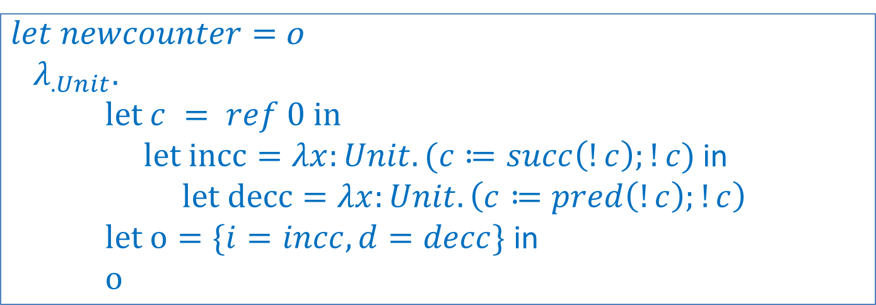
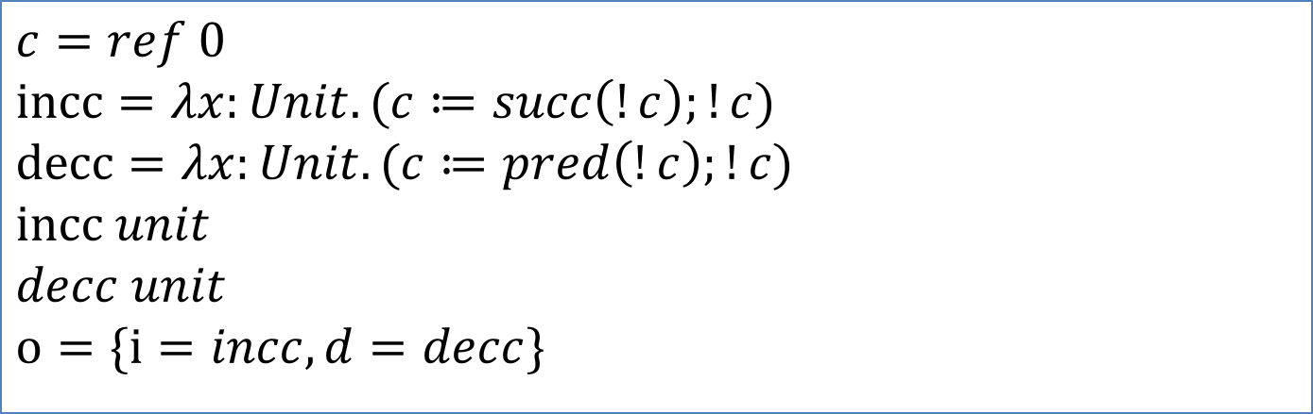
Example
$$c=ref 0$$
$$incc=λx:Unit. (c≔succ\left(!c\right);!c)$$
$$decc=λx:Unit. (c≔pred\left(!c\right);!c)$$
$$incc unit$$
$$decc unit$$
$$o=\{i=incc, d=decc\}$$
$let newcounter=$o
$${ λ}_{.Unit}.$$
$let c = ref 0 in$
$let incc=λx:Unit. (c≔succ\left(!c\right);!c)$ in
$let decc=λx:Unit. \left(c≔pred\left(!c\right);!c\right)$
$let o=\{i=incc, d=decc\}$ in
$o$

Slide 16
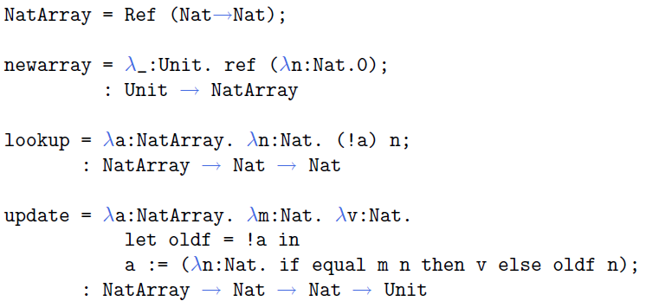
Example

Slide 17
How to enrich the language with the new mechanism ？

Slide 18
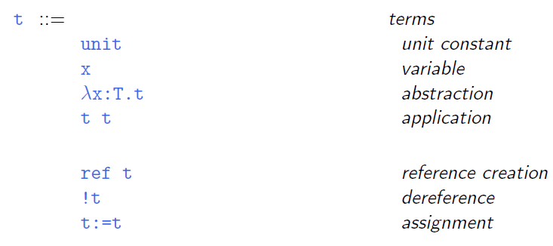

Syntax
... plus other familiar types, in examples.

Slide 19
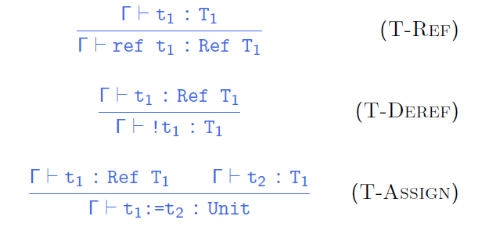
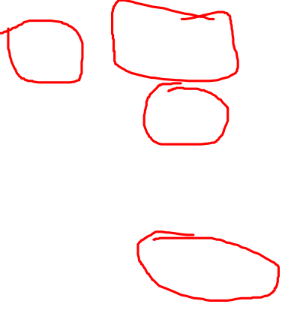
Typing rules
type system
a set of rules that assigns a property called type to
the various “constructs “ of a computer program, such as
variables, expressions, functions or module
Notes:
Strong typed system
type system is a set of rules that assigns a property called type to the various “constructs “ of a computer program, such as variables, expressions, functions or module
A type system associates a type with each computed value and, by examining the flow of these values, attempts to ensure or prove that no type errors can occur.
Type systems are often specified as part of programming languages, and built into the interpreters and compilers for them;
although the type system of a language can be extended by optional tools that perform added kinds of checks using the language's original type syntax and grammar.

Slide 20

Evaluation
What is the value of the expression ref 0 ?
Is
r = ref 0
s = ref 0
and
r = ref 0
s = r
behave the same?
Crucial observation: evaluating ref 0 must do something ?
Specifically, evaluating ref 0 should allocate some storage and yield a reference (or pointer) to that storage.
So what is a reference?

Slide 21
The store
A reference names a location in the store (also known as the heap or just the memory).
What is the store?
Concretely: an array of 8-bit bytes, indexed by 32/64-bit integers.
More abstractly: an array of values.
Even more abstractly: a partial function from locations to values.

Slide 22
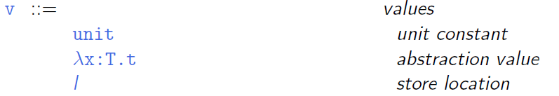

Locations
Syntax of values:
... and since all values are terms ...

Slide 23
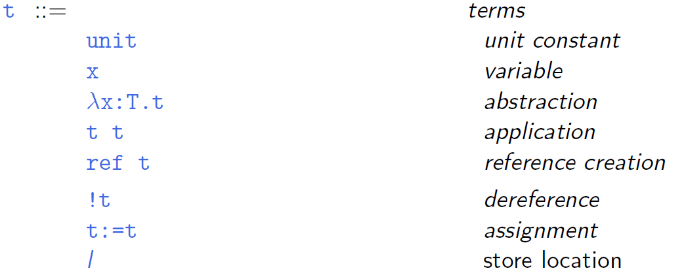

Syntax of Terms

Slide 24
Aside
Does this mean we are going to allow programmers to write explicit locations in their programs??
No: This is just a modeling trick.
We are enriching the “source language” to include some runtime structures, so that we can continue to formalize evaluation as a relation between source terms.
Aside: If we formalize evaluation in the big-step style, then we can add locations to the set of values (results of evaluation) without adding them to the set of terms.
Notes:
Operational semantics are a category of formal programming language semantics in which certain desired properties of a program, such as correctness, safety or security, are verified by constructing proofs from logical statements about its execution and procedures, rather than by attaching mathematical meanings to its terms (denotational semantics).
Operational semantics are classified in two categories: structural operational semantics (or small-step semantics) formally describe how the individual steps of a computation take place in a computer-based system. By opposition natural semantics (or big-step semantics) describe how the overall results of the executions are obtained.
There are a number of distinctions between small-step and big-step semantics that influence whether one or the other forms a more suitable basis for specifying the semantics of a programming language.
Big-step semantics have the advantage of often being simpler (needing fewer inference rules) and often directly correspond to an efficient implementation of an interpreter for the language (hence Kahn calling them "natural".) Both can lead to simpler proofs, for example when proving the preservation of correctness under some program transformation.
The main disadvantage of big-step semantics is that non-terminating (diverging) computations do not have an inference tree, making it impossible to state and prove properties about such computations.^{[4]}
Small-step semantics give more control of the details and order of evaluation. In the case of instrumented operational semantics, this allows the operational semantics to track and the semanticist to state and prove more accurate theorems about the runtime behaviour of the language. These properties make small-step semantics more convenient when proving type soundness of a type system against an operational semantics.^{[4]}

Slide 25

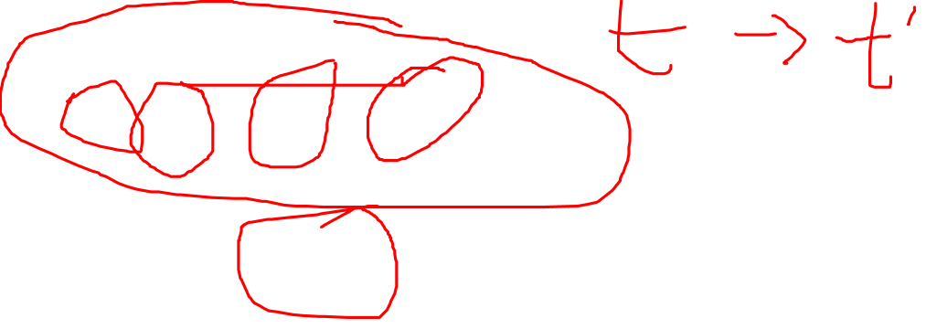
Evaluation
The result of evaluating a term now (with references)
depends on the store in which it is evaluated.
is not just a value — we must also keep track of the changes that get made to the store.
i.e., the evaluation relation should now map a term as well as a store to a reduced term and a new store.
$t | μ → t^{′} | μ′$
To use the metavariable $μ$ to range over stores.
Notes:
增添reference后，value有被修改的可能，

Slide 26
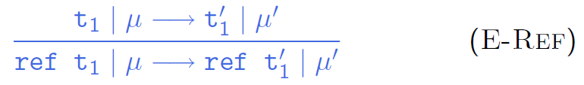
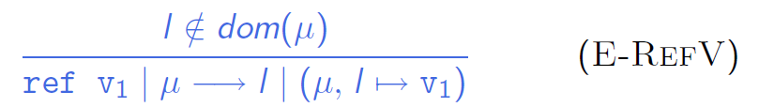
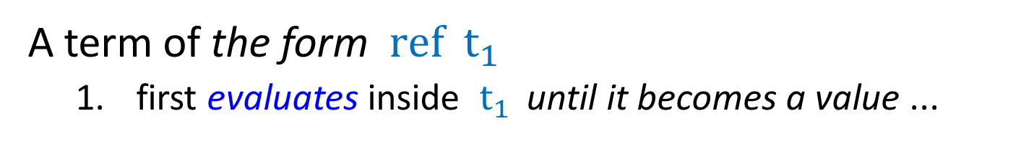

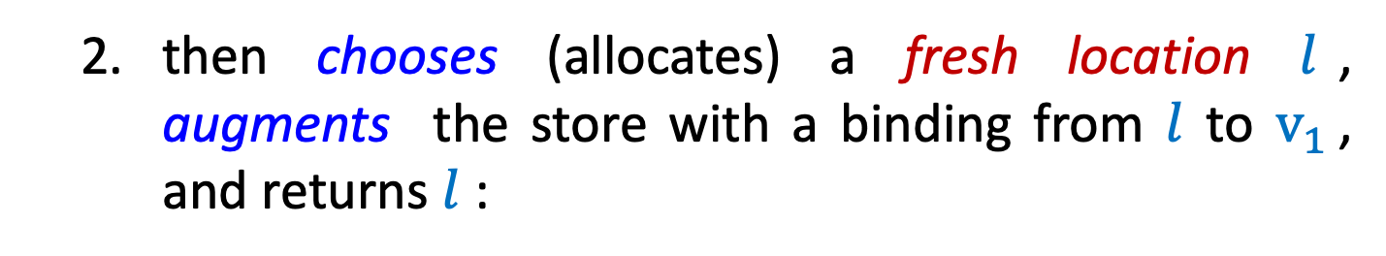
Evaluation
A term of the form ${ref t}_{1 }$
first evaluates inside $t_{1 }$ until it becomes a value ...
then chooses (allocates) a fresh location $l$, augments the store with a binding from $l$ to $v_{1 }$, and returns $l$ :
Notes:
L is said to be fresh for \miu

Slide 27
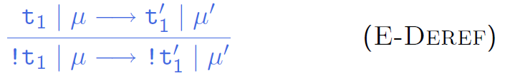
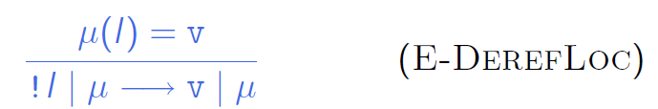

Evaluation
A term !t₁ first evaluates in t₁ until it becomes a value...
... and then
looks up this value (which must be a location, if the original term was well typed) and
returns its contents in the current store

Slide 28
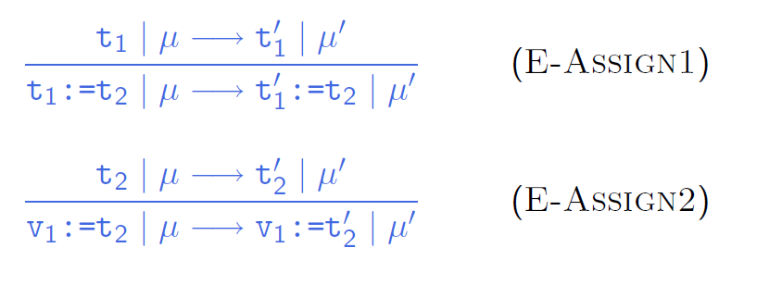
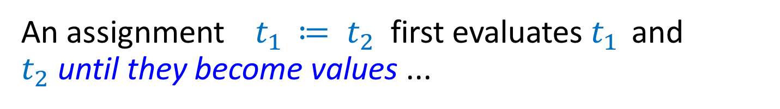
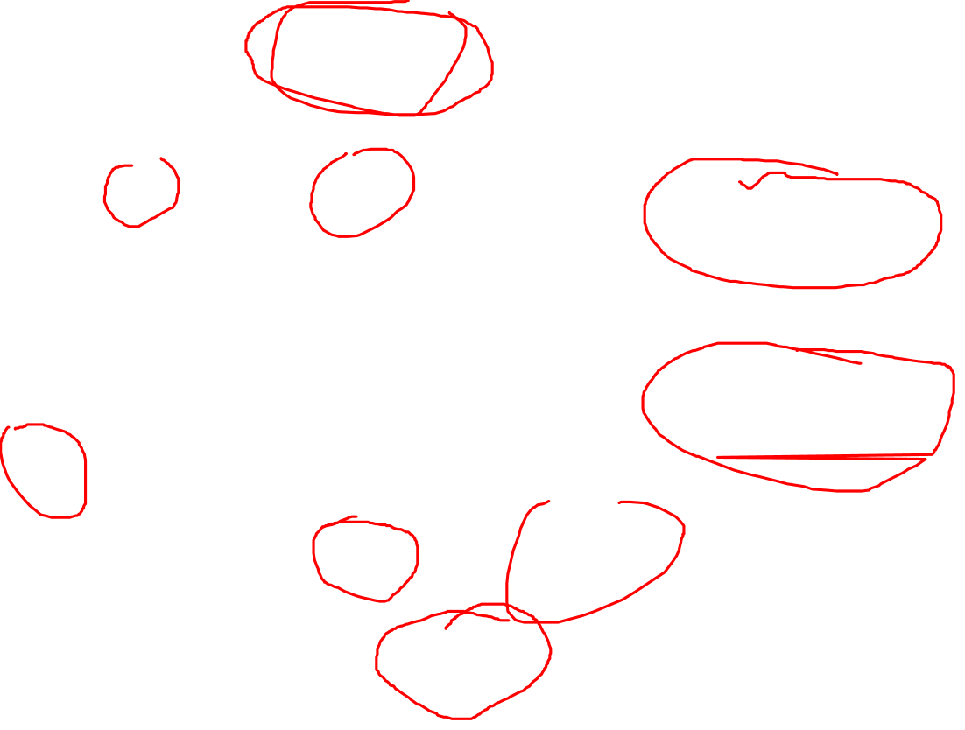
Evaluation
An assignment $t_{1 }≔ t_{2}$ first evaluates $t_{1 }$ and $t_{2}$until they become values ...
... and then returns unit and updates the store:

Slide 29
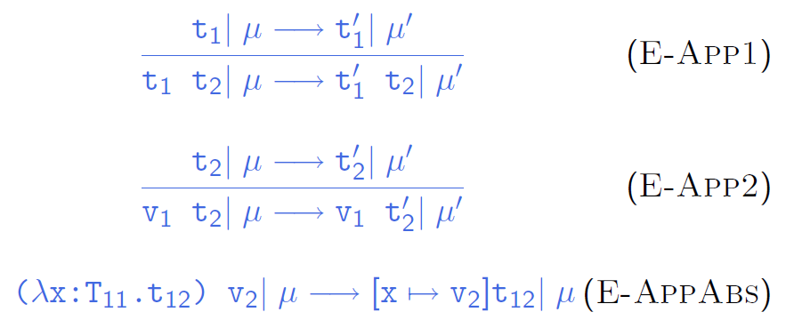

Evaluation
Evaluation rules for function abstraction and application are augmented with stores, but don’t do anything with them directly.

Slide 30
Aside
Garbage Collection
Note that we are not modeling garbage collection — the store just grows without bound.
It may not be problematic for most theoretical purposes, whereas it is clear that for practical purposes some form of deallocation of unused storage must be provided.
Pointer Arithmetic
p++;
We can’t do any!

Slide 31
Store Typing
Notes:
之前 store

Slide 32

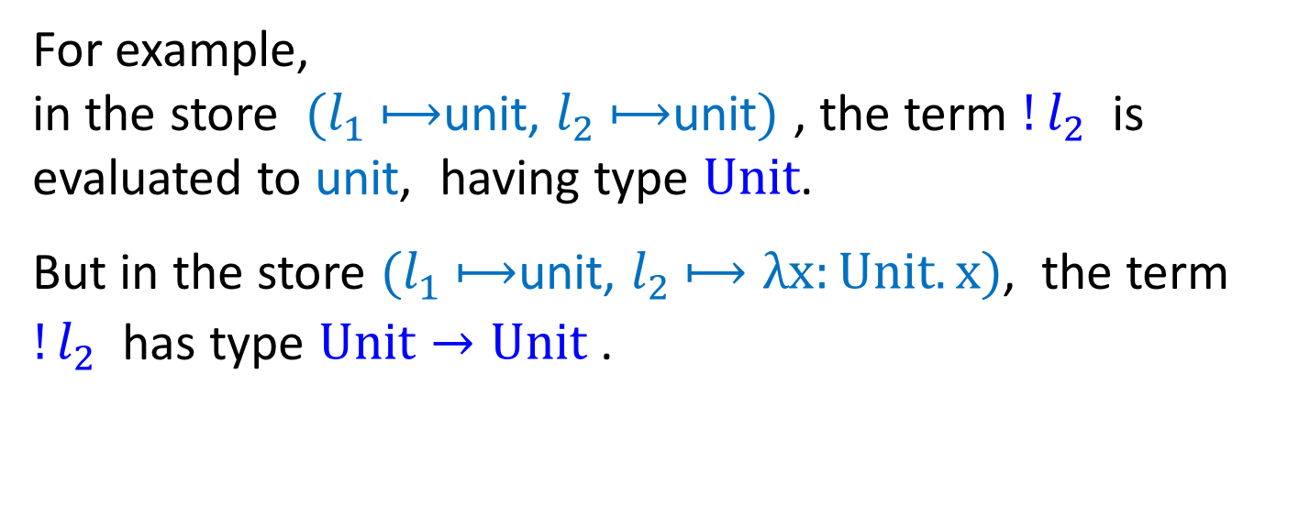
Typing Locations
Question: What is the type of a location?
Answer: Depends on the contents of the store!
For example,
in the store $(l_{1}$ $⟼$unit, $l_{2}$ $⟼$unit$)$ , the term ${!l}_{2}$ is evaluated to unit, having type $Unit$.
But in the store $(l_{1}$ $⟼$unit, $l_{2}$ $⟼λx:Unit.x)$, the term ${!l}_{2}$ has type $Unit→Unit$ .

Slide 33
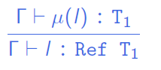
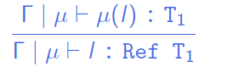
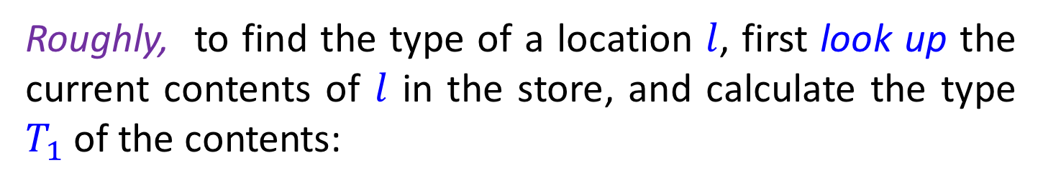

Typing Locations — first try
Roughly, to find the type of a location $l$, first look up the current contents of $l$ in the store, and calculate the type $T_{1}$ of the contents:
More precisely, to make the type of a term depend on the store (keeping a consistent state), we should change the typing relation from three-place to :
i.e., typing is now a four-place relation (about contexts, stores, terms, and types), though the store is a part of the context ……
Notes:
根据l 中存储内容来确定其类型
term的类型，除了context之外，还依赖于存储store

Slide 34
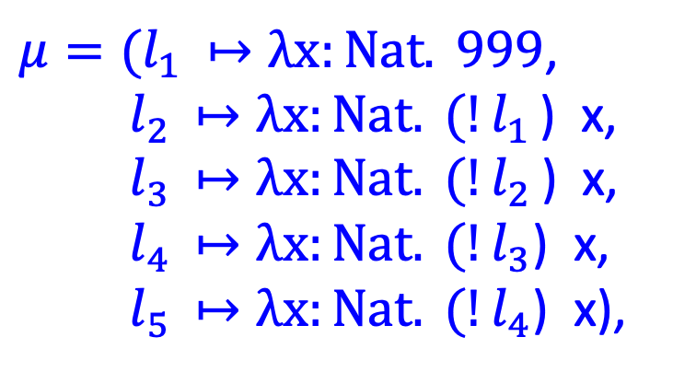

Problems #1
However, this rule is not completely satisfactory, and is rather inefficient.
First of all, it can make typing derivations very large (if a location appears many times in a term) !
e.g., if
$μ=(l_{1 }↦λx:Nat. 999$,
$l_{2 }↦λx:Nat. (!l_{1 }$) x,
$l_{3 }↦λx:Nat. (!l_{2 }$) x,
$l_{4 }↦λx:Nat. (!l_{3}$) x,
$l_{5 }↦λx:Nat. (!l_{4}$) x),
then how big is the typing derivation for ${!l}_{5}$?

Slide 35
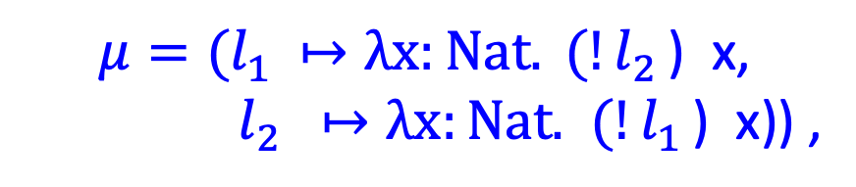
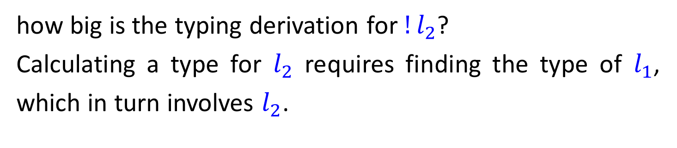
Problems #2
But wait... it gets worse if the store contains a cycle. Suppose
$$μ=(l_{1 }↦λx:Nat. (!l_{2 }\text{) }\text{x}\text{,}$$
$l_{2 } ↦λx:Nat.$ $(!l_{1 }$) x)) ,
how big is the typing derivation for ${!l}_{2}$?
Calculating a type for $l_{2}$ requires finding the type of $l_{1}$, which in turn involves $l_{2}$.
Notes:
为什么？

Slide 36
Why?
What leads to the problems?
Our typing rule for locations requires us to recalculate the type of a location every time it’s mentioned in a term, which should not be necessary.
In fact, once a location is first created, the type of the initial value is known, and the type will be kept even if the values can be changed.

Slide 37
Store Typing
Observation:
The typing rules we have chosen for references guarantee that a given location in the store is always used to hold values of the same type.
These intended types can be collected into a store typing:
— a partial function from locations to types.

Slide 38
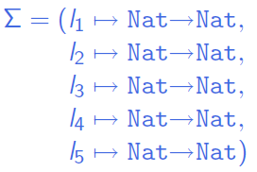
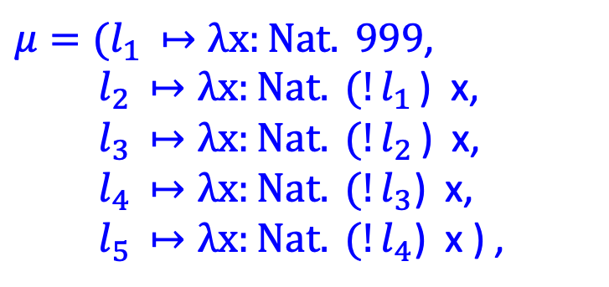

Store Typing
E.g., for
A reasonable store typing would be
$μ=(l_{1 }↦λx:Nat. 999$,
$l_{2 }↦λx:Nat. (!l_{1 }$) x,
$l_{3 }↦λx:Nat. (!l_{2 }$) x,
$l_{4 }↦λx:Nat. (!l_{3}$) x,
$l_{5 }↦λx:Nat. (!l_{4}$) x ) ,

Slide 39
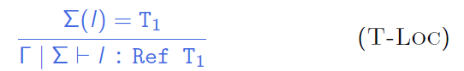
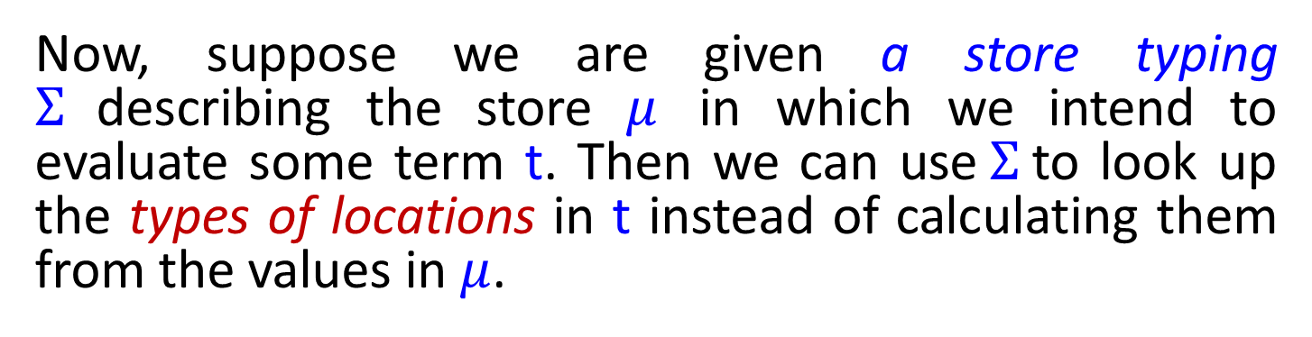

Store Typing
Now, suppose we are given a store typing $Σ$describing the store $μ$ in which we intend to evaluate some term t. Then we can use $Σ$ to look up the types of locations in t instead of calculating them from the values in $μ$.
i.e., typing is now a four-place relation on contexts, store typings, terms, and types.
Proviso: the typing rules accurately predict the results of evaluation only if the concrete store used during evaluation actually conforms to the store typing.
Notes:
plural provisos: 限制性条款
with the proviso that ...
附加条件是…

Slide 40
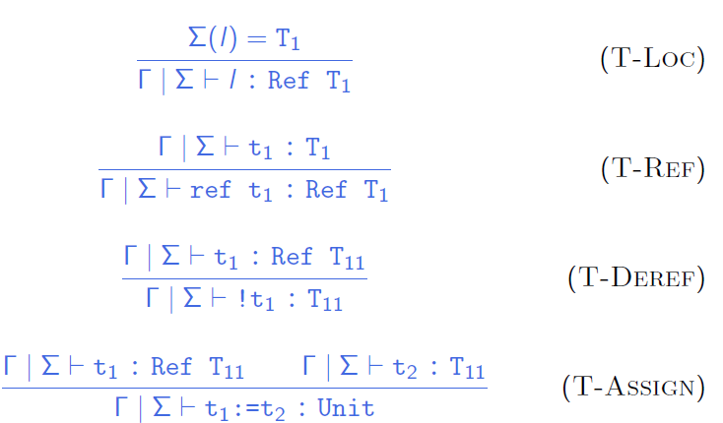

Final typing rules

Slide 41
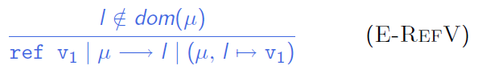
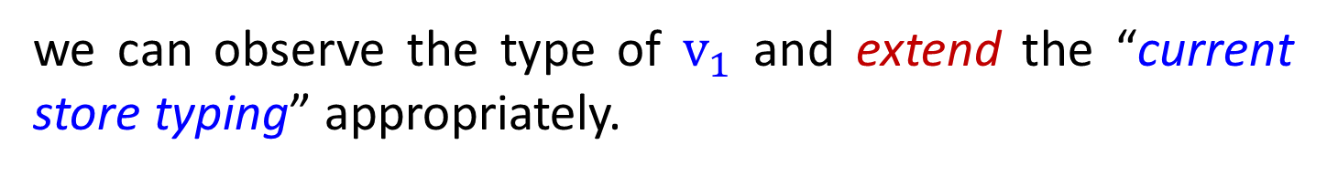

Store Typing
Question: Where do these store typings come from?
Answer: When we first typecheck a program, there will be no explicit locations, so we can use an empty store typing, since the locations arise only in terms that are the intermediate results of evaluation.
So, when a new location is created during evaluation,
we can observe the type of $v_{1}$ and extend the “current store typing” appropriately.
Notes:
\sigma (store typing) 如何构建？

Slide 42
Store Typing
As evaluation proceeds and new locations are created, the store typing is extended by looking at the type of the initial values being placed in newly allocated cells.
∑ only records the association
between
already-allocated storage cells and
their types.

Slide 43
Safety
Coherence between the statics and the dynamics
Well-formed programs are well-behaved
Notes:
Type safety expresses the coherence between the statics and the dynamics.
Most programming languages exhibit a phase distinction between the static and dynamic phases of processing:
The static phase consists of parsing and type checking to ensure that the program is well-formed; the dynamic phase consists of execution of well-formed programs.
A language is said to be safe exactly when well-formed programs are well-behaved when executed.
The static phase is specified by a statics comprising a collection of rules for deriving typing judgments stating that an expression is well-formed of a certain type.
Types mediate the interaction between the constituent parts of a program by “predicting” some aspects of the execution behaviors of the parts so that we may ensure they fit together properly at runtime.
Type safety tells us that these predictions are accurate; if not, the statics is considered to be improperly defined, and the language is deemed unsafe for execution.

Slide 44
Preservation
the steps of evaluation
preserve
typing

Slide 45

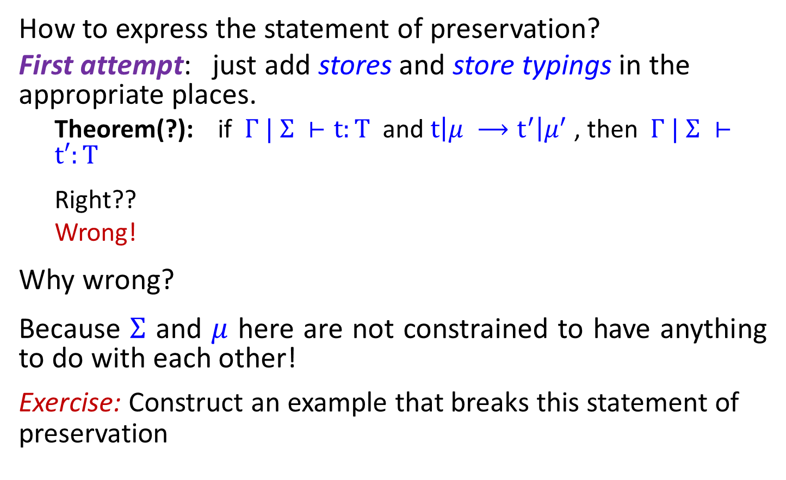
Preservation
How to express the statement of preservation?
First attempt: just add stores and store typings in the appropriate places.
Theorem(?): if $Γ | Σ ⊢t:T$ and $t\left|μ ⟶t^{′}\right|μ^{′}$, then $Γ | Σ ⊢t′:T$
Right??
Wrong!
Why wrong?
Because $Σ$ and $μ$ here are not constrained to have anything to do with each other!
Exercise: Construct an example that breaks this statement of preservation
Notes:
(Exercise on class : Construct an example that breaks this statement of
preservation.)！！！

Slide 46

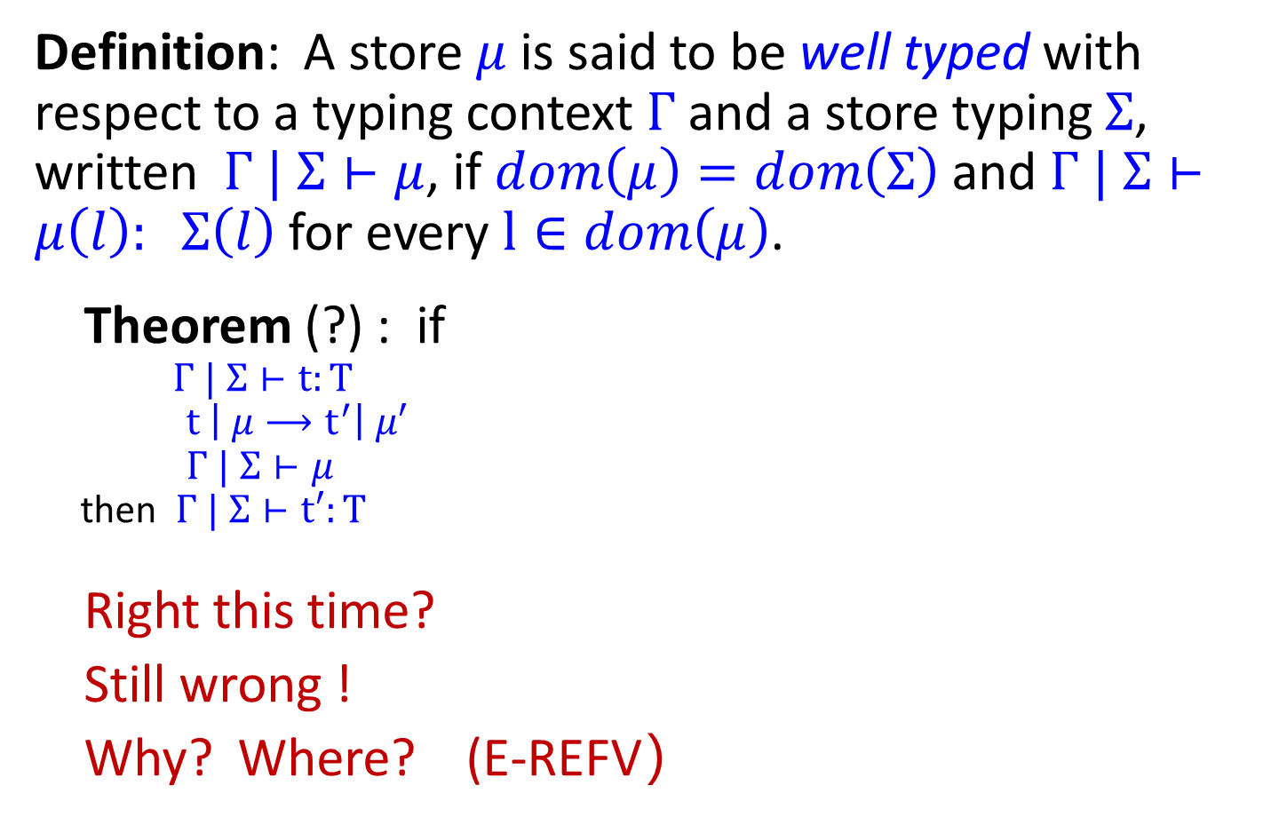
Preservation
Definition: A store $μ$ is said to be well typed with respect to a typing context $Γ$and a store typing $Σ$, written $Γ | Σ⊢μ$, if $dom\left(μ\right)=dom\left(Σ\right)$and $Γ | Σ⊢μ\left(l\right): Σ\left(l\right)$ for every $l∈dom\left(μ\right)$.
Theorem (?) : if
$Γ | Σ⊢t:T$
$t \left| μ⟶t^{′}\right| μ′$
$Γ | Σ⊢μ$
then $Γ | Σ⊢t′:T$
Right this time?
Still wrong !
Why? Where? (E-REFV）
Notes:
直觉上，If every value om the store has the type predicated by the store typing, then a store \mu is consistent with a store typing \Sigma
How about allocation rule?

Slide 47
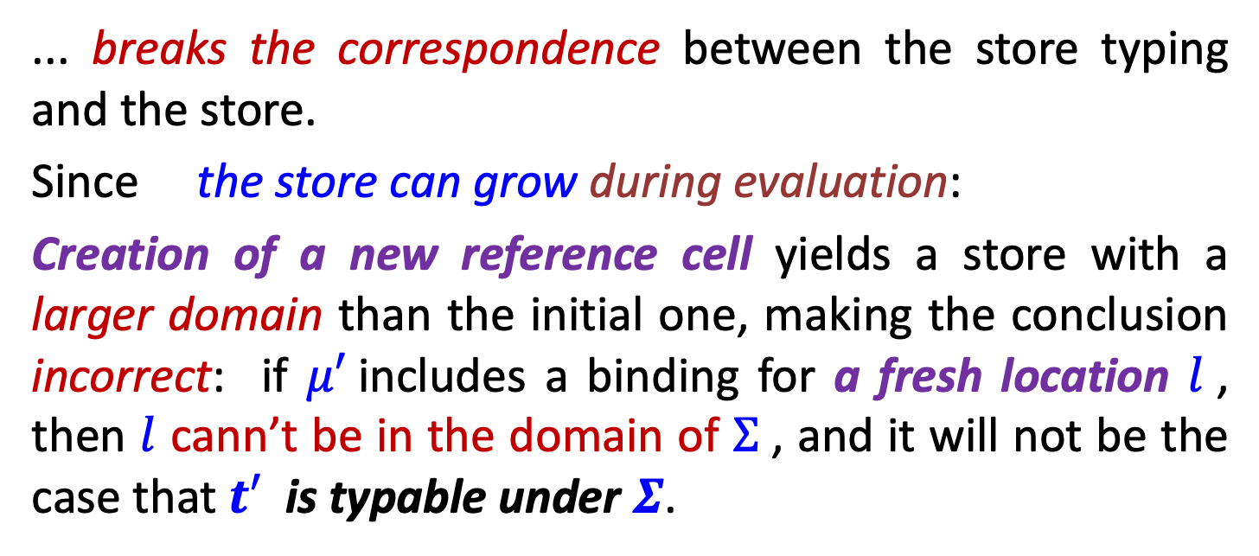
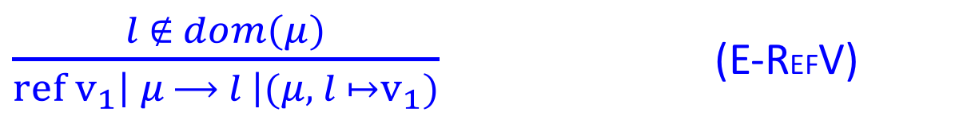

Preservation
Creation of a new reference cell ...
$\frac{l ∉ dom\left(μ\right)}{ref v_{1}\left| μ ⟶ l \right|(μ, l ↦v_{1})}$ (E-REFV)
... breaks the correspondence between the store typing and the store.
Since the store can grow during evaluation:
Creation of a new reference cell yields a store with a larger domain than the initial one, making the conclusion incorrect: if $μ′$includes a binding for a fresh location $l$, then $l$ cann’t be in the domain of $Σ$, and it will not be the case that $t′$ is typable under $Σ$.

Slide 48
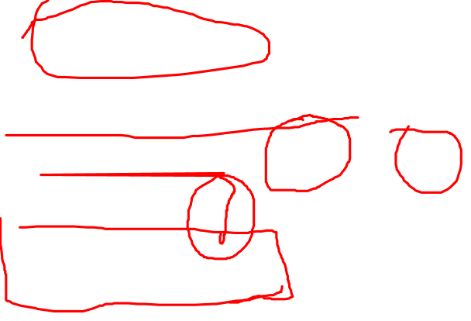
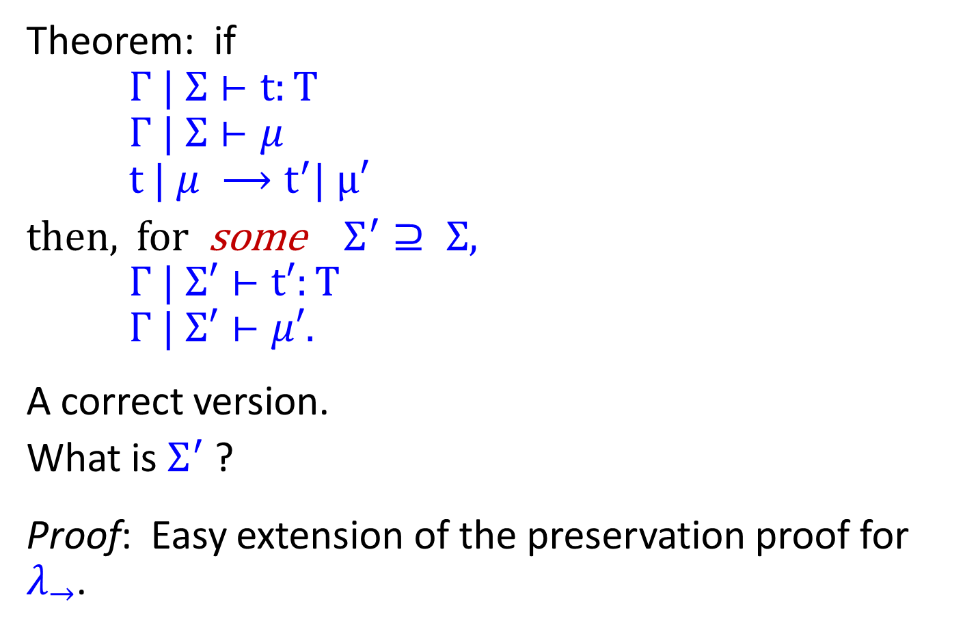
Preservation
Theorem: if
$Γ | Σ⊢t:T$
$Γ | Σ⊢μ$
$t | μ ⟶t^{′}| μ′$
then, for some $Σ^{′}⊇ Σ$,
$Γ | Σ′⊢t′:T$
$Γ | Σ′⊢μ′$.
A correct version.
What is $Σ^{′}$ ?
Proof: Easy extension of the preservation proof for $λ_{→}$.
Notes:
\Sigma’ is either \Sigma or (\mu, l \derive T)

Slide 49
Progress
well-typed expressions are
either values
or can be further evaluated
Notes:
The dynamics of a language is a description of how programs are to be executed.
The most important way to define the dynamics of a language is by the method of structural dynamics,
which defines a transition system that inductively specifies the step-by-step process of executing a program.

Slide 50

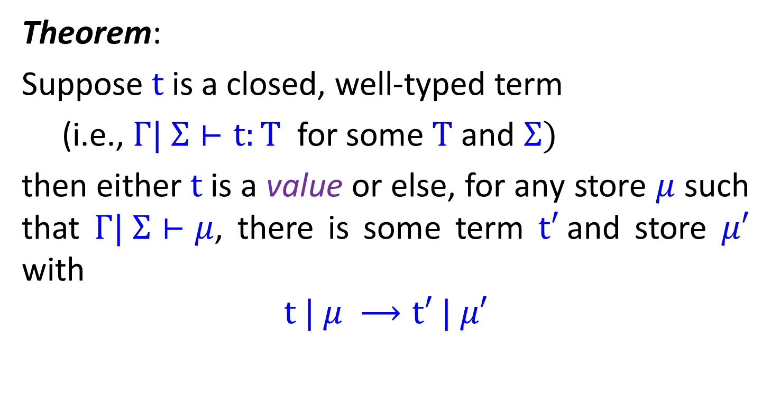
Progress
Theorem:
Suppose $t$ is a closed, well-typed term
(i.e., $Γ| Σ⊢t:T$ for some $T$ and $Σ)$
then either$t$ is a value or else, for any store $μ$ such that $Γ| Σ⊢μ$, there is some term $t′$and store $μ′$ with
$$t | μ ⟶t′ | μ′$$

Slide 51
Safety
preservation and progress together constitute the proof of safety
progress theorem ensures that well-typed expressions don’t get stuck in an ill-defined state, and
preservation theorem ensures that if a step is a taken the result remains well-typed (with the same type).
These two parts ensure the statics and dynamics are coherent, and that no ill-defined states can ever be encountered while evaluating a well-typed expression

Slide 52
In summary …

Slide 53
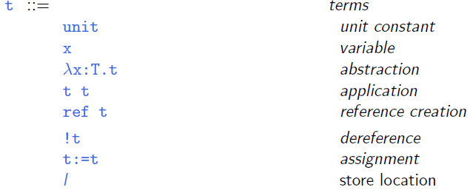

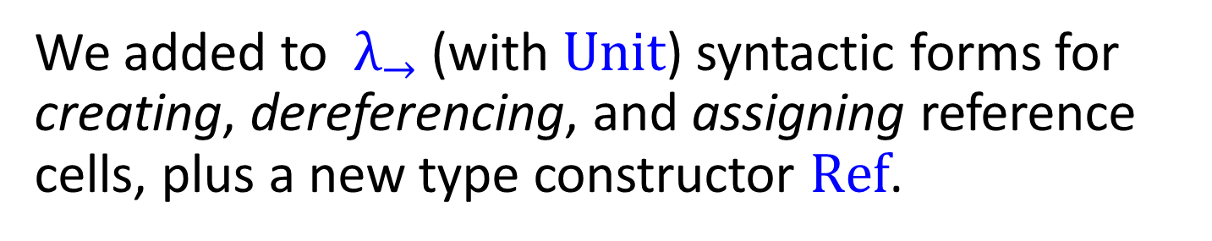
Syntax
We added to $λ_{→}$ (with $Unit$) syntactic forms for creating, dereferencing, and assigning reference cells, plus a new type constructor $Ref$.

Slide 54
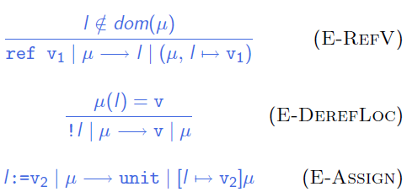


Evaluation
Evaluation relation: $t | μ ⟶ t′ | μ′$

Slide 55
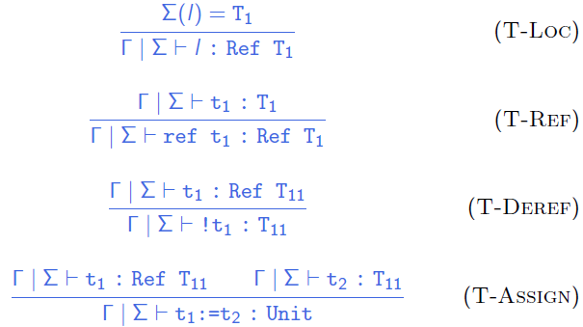

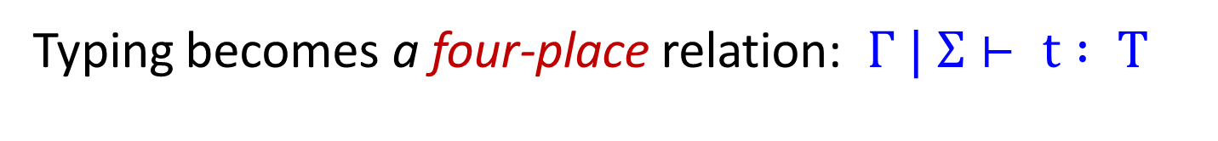
Typing
Typing becomes a four-place relation: $Γ | Σ⊢ t : T$

Slide 56

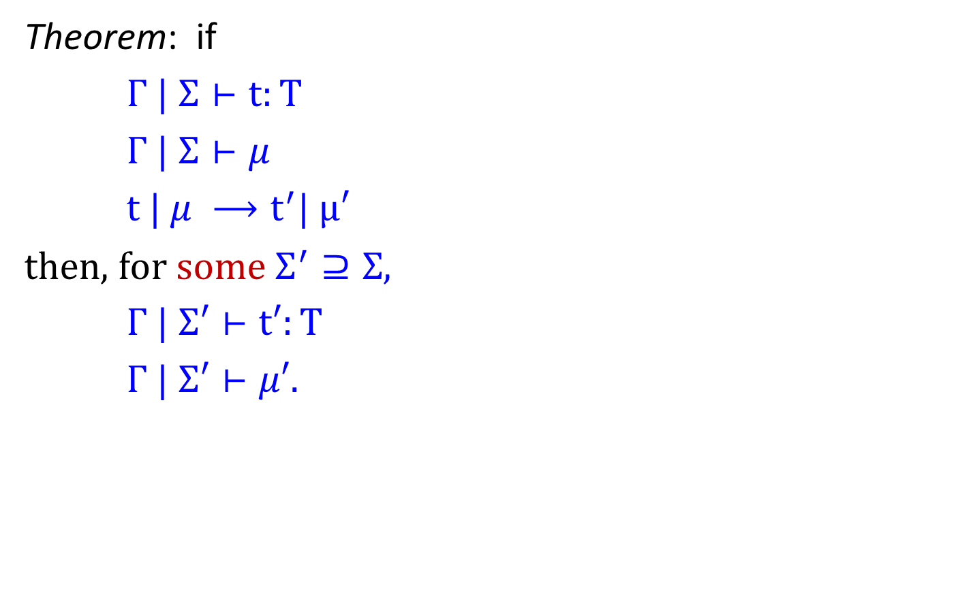
Preservation
Theorem: if
$Γ | Σ⊢t:T$
$Γ | Σ⊢μ$
$t | μ ⟶t^{′}| μ′$
then, for some $Σ^{′}⊇Σ$,
$Γ | Σ′⊢t′:T$
$Γ | Σ′⊢μ′$.
Notes:
The preservation theorem merely asserts that there is some store typing \Sigma’ contains \Sigma, such that the new term t’ is well typed w.r.t. \Sigma’, it does not tell us what \Sigma’is. It’s clear that \Sigma’ is either \Sigma or else it is exactly (\mu, l-> T1), where l is the newly allocated location.

Slide 57
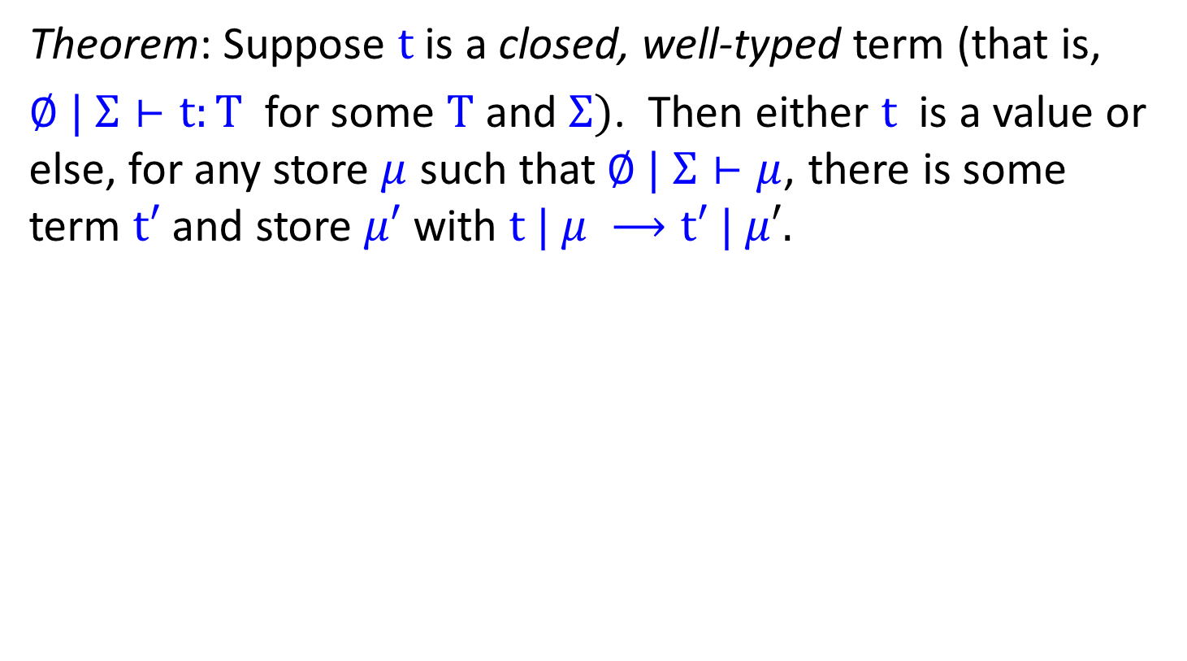
Progress
Theorem: Suppose $t$ is a closed, well-typed term (that is,
$∅ | Σ⊢t:T$ for some $T$ and $Σ)$. Then either $t$ is a value or else, for any store $μ$ such that$∅ | Σ⊢μ$, there is some term $t′$and store $μ′$ with $t | μ ⟶t′ | μ′.$
Notes:
The combination of preservation and progress together constitute the proof of safety: the progress theorem ensures that well-typed expressions don’t get stuck in an ill-defined state, and preservation theorem ensures that if a step is a taken the result remains well-typed (with the same type).
These two parts work hand-in-hand to ensure the statics and dynamics are coherent, and that no ill-defined states can ever be encountered while evaluating a well-typed expression.

Slide 58
Others …

Slide 59
Arrays
Fix-sized vectors of values. All of the values must have the same type, and the fields in the array can be accessed and modified.
e.g., arrays can be created with in Ocaml
[|e₁; … ; e_{n}|]
# let a = [|1;3;5;7;9|];;
val a : int array = [|1;3;5;7;9|]
#a;;
-: int array = [|1;3;5;7;9|]

Slide 60
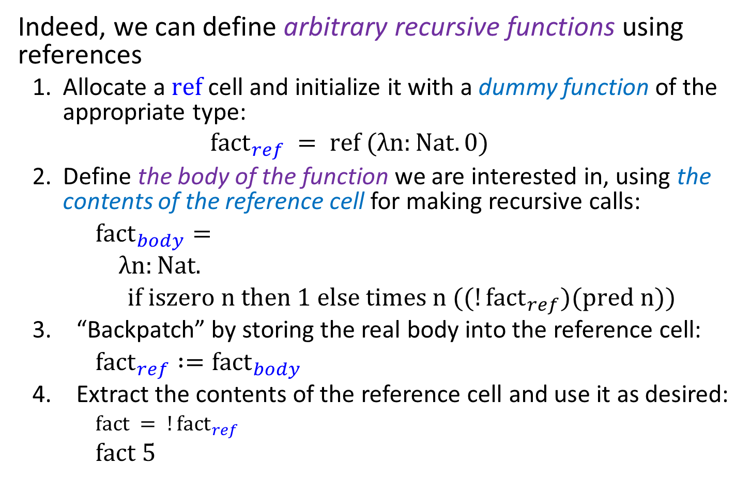
Recursion via references
Indeed, we can define arbitrary recursive functions using references
Allocate a $ref$ cell and initialize it with a dummy function of the appropriate type:
$${fact}_{ref} = ref (λn:Nat.0)$$
Define the body of the function we are interested in, using the contents of the reference cell for making recursive calls:
${fact}_{body}=$
$λn:Nat.$
$if iszero n then 1 else times n ((!{fact}_{ref})(pred n))$
“Backpatch” by storing the real body into the reference cell:
${fact}_{ref} :={fact}_{body}$
Extract the contents of the reference cell and use it as desired:
$fact = !{fact}_{ref}$
$fact 5$

Slide 61

Homework☺
Read chapter 13
Read and chew over the codes of fullref.
HW: 13.3.1 and 13.5.2
Preview chapter 14

Slide 62
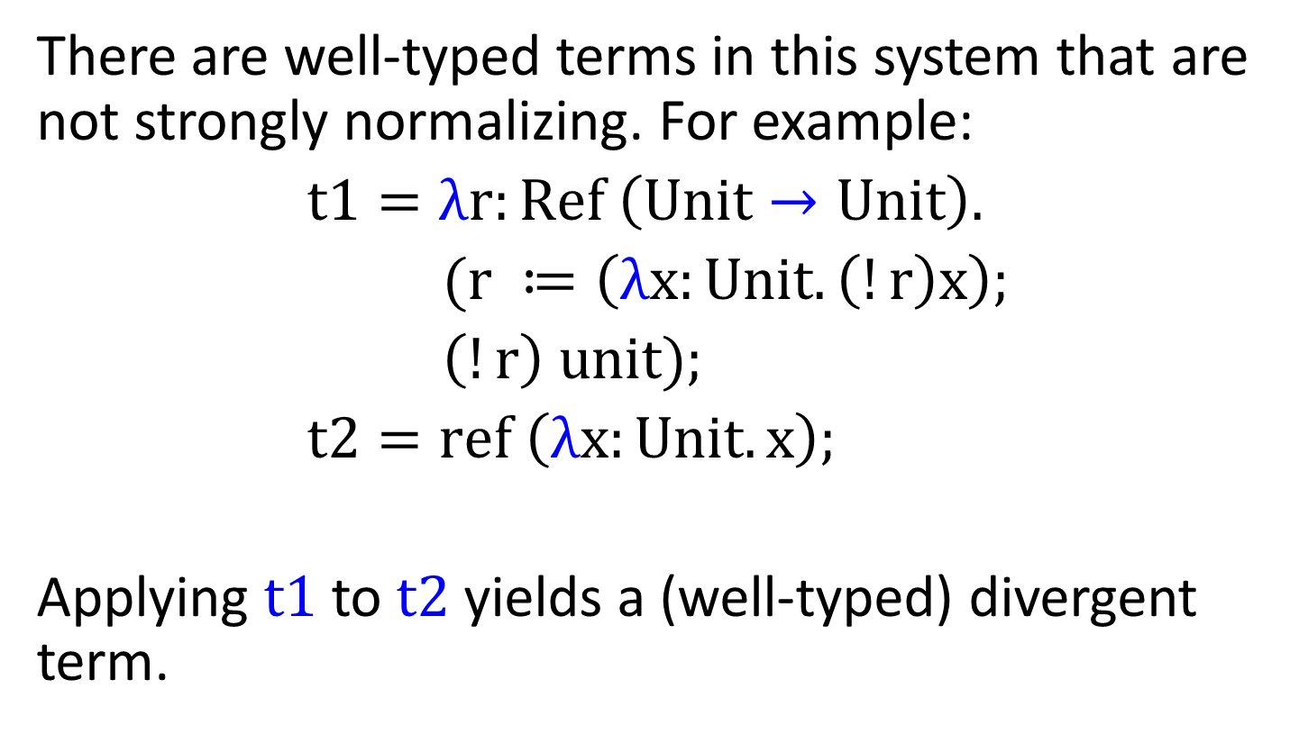
Nontermination via references
There are well-typed terms in this system that are not strongly normalizing. For example:
$t1=λr:Ref \left(Unit→Unit\right).$
$(r ≔\left(λx:Unit. \left(!r\right)x\right);$
$\left(!r\right) unit);$
$t2=ref \left(λx:Unit. x\right);$
Applying $t1$ to $t2$ yields a (well-typed) divergent term.

